Slide 1
Meta-Learning in Neural Networks: A Survey
Short story by Teepika Ramasamy Marimuthu

Slide 2
What is Meta Learning or Learning-to-learn?
Meta learning improvises the learning algorithm with the help of multiple learning episodes. It’s a process of learning from distribution of related tasks and utilizing them for solving future tasks. Meta learning aims to solve the task at hand by generalising to many different tasks with minimum amount of data.
Instead of using a fixed learning algorithm to solve a problem, Meta Learning learns the algorithm itself to solve the problem.
It learns a general purpose algorithm that generalizes to do better on upcoming task than the last task with the learning from the task family.

Slide 3
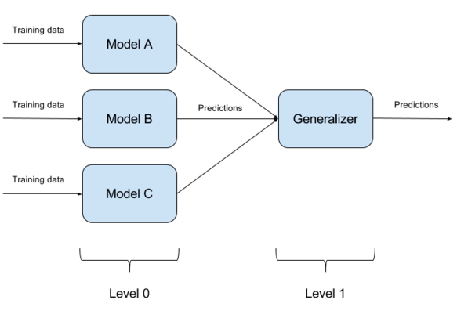
Meta learning solves the problem in two stages
Base learning/Inner or Lower learning
Meta-learning/Outer or Upper learning

Slide 4
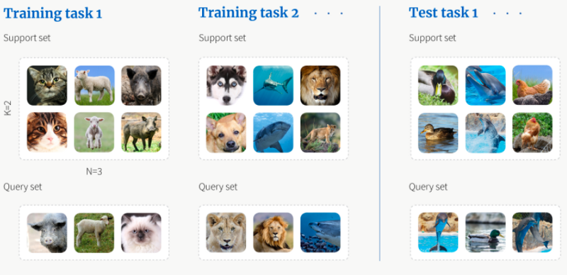
Instance - A 3-way-2-shot classification problem

Slide 5
Meta learning against other related fields
Transfer Learning: In transfer learning, there is no scope for meta-objective.
Domain Adaptation (DA) and Domain Generalization (DG): Domain Adaptation and Domain Generalization attempts to alleviate issues created by domain shift. Meta Learning methods can be used to do DA and DG.
Continual Learning: Continual Learning process doesn’t solve for the meta objective explicitly as meta learning.
Multi task Learning: The result of multi task learning is the shared representation learnt from the various tasks.
AutoML: Meta Learning can be considered as specialization of AutoML.

Slide 6
Proposed Taxonomy (or classification ) of Meta learning
Meta-Representation (“What”) — The first axis is about the choice of meta knowledge, which means meta learning methods makes different choices on meta knowledge ranging from initial model parameters to readable code in case of program induction.
Meta-Optimizer (“How”) — The second axis is about the choice of optimizer to be used in the outer or upper learning.
Meta-Objective (“Why”) — The third axis is about the choice of goal for the meta learning problem by controlling the meta objective.

Slide 7
Applications of Meta Learning
Computer Vision and Graphics: Few shots multi class image recognition, few shots object detection etc
Meta Reinforcement Learning and Robotic: RL generally suffers from extreme sample inefficiency because of sparse rewards, need for exploration.
Neural Architecture Search: Architecture search can be considered as one of hyperparameter optimization problem where the objective is find the optimal architecture for the network.
Hyper-parameter Optimization: Hyperparameters optimization is solved through metalearning by learning hyperparameters that improve training over a distribution of tasks.

Slide 8
Applications of Meta Learning
Bayesian Meta-learning: By providing efficient adaptive sampling methods, meta learning aids Bayesian inference process
Language and Speech: Few shot language modeling shows the versatility of Meta Learning.
Meta Learning lends to address challenges that give good social impact like drugs discovery, medical image classification where resource/data is often rare. Also MAML is adapted to detect breast cancer, to do medical visual question answering, skin lesion segmentation tasks.

Slide 9
Challenges and Open Questions:
Diverse and multi modal task distribution: While choosing from a diverse and wide task distribution, Meta Learning challenges the existing methods for effective results because of the conflicting gradients between tasks.
Meta Generalization: Meta learning poses generalization challenge similar to generalization across instances in traditional Machine Learning.
Task Families: Many Meta Learning frameworks requires task families for meta-training but unfortunately data for some task families may not be available.
Computation cost and Many shot: Bilevel optimization in Meta Learning requires are memory intensive and time consuming processes.

Slide 10
Conclusion
Meta Learning has attracted great interest and attention. It comes with some level of confusion with its related fields. This short story on the survey paper focuses on addressing the confusion, understand the applications and issues in implementing them in real world problems.

